Slide 1
Service provider part
Agenda
Introduction
Requirements to design service provider network
Architecture
Neighborship attitude
  Implemented protocols and features
  Testing and Assurance

Slide 2
Service provider part
Introduction
The definition of service provider.
What is the difference between ISP and SP ?
What is the difference between Private public WAN ?

Slide 3
Service provider part
Design Requirements
Performance
Scalability
Availability
Qos
Manageability
Security

Slide 4
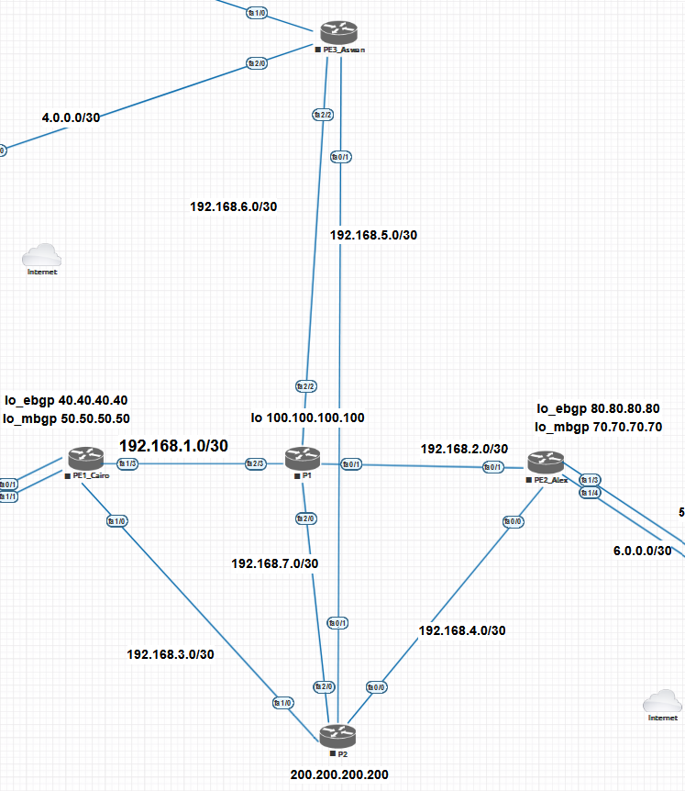
Service provider part
Architecture
Provider routers ( router reflector )
P1
P2
Provider edge routers
PE1_Cairo
PE2_Alex
PE3_Aswan

Slide 5
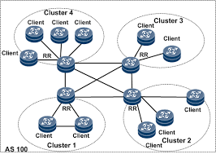
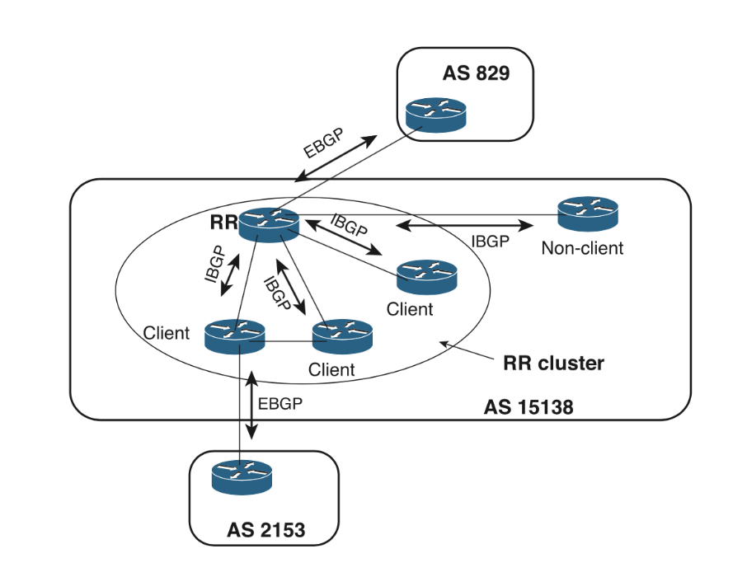
Service provider part
Neighborship attitude
Route reflector neighborship ( RR )
Provider edge neighborship ( Client )
RR cluster ID
Originator ID

Slide 6
Service provider part
Implementation of protocols and features
OSPF ( for pingable network )
BGP ( External Neighborship )
BGP Router reflector ( Internal Neighborship )
Multi-protocol BGP
VPNV4 address family
Route distinguisher ( 96 bits )
Route target ( 64 bits )
MPLS activation ( LDP Protocol )
BGP and MPLS Authentication

Slide 7
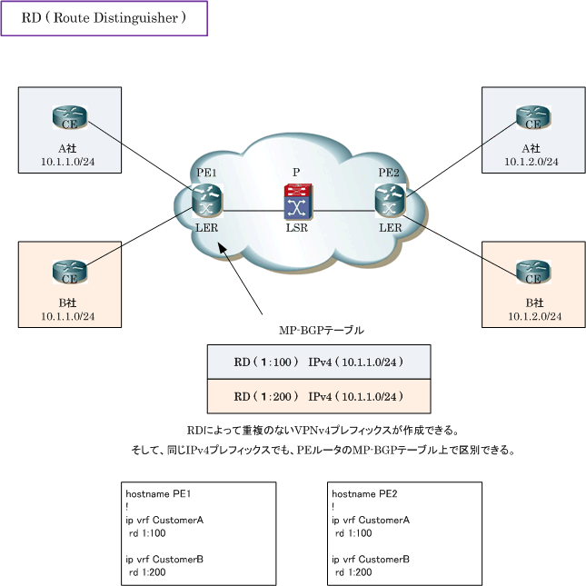

Slide 8
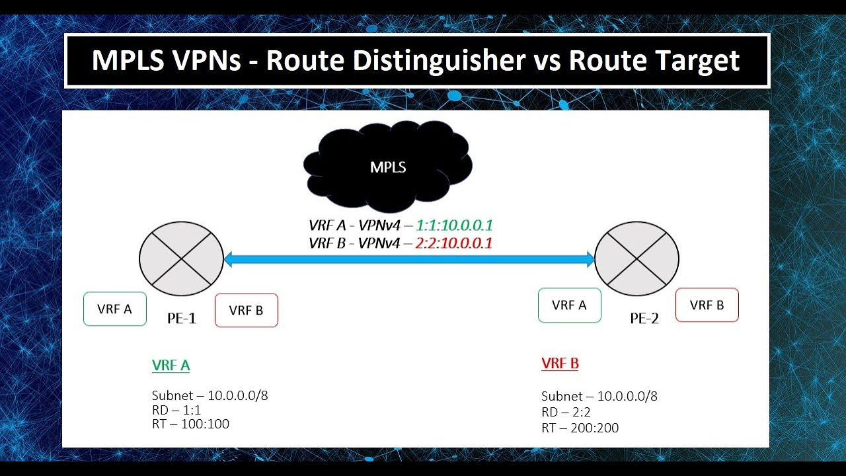

Slide 9
Service provider part
Testing and assurance
Verify BGP peering : show ip bgp summary
Verify BGP Routes : show ip bgp
Verify MP-BGP Configuration: show bgp vpnv4 unicast all summary
Verify MPLS Configuration: show mpls forwarding-table

Slide 10
THANK YOU!

